Slide 1
Minventory App
Lukas Willin - https://github.com/LukasWilllinFHNW/MInventory
Oop2 Semester Projekt

Slide 2
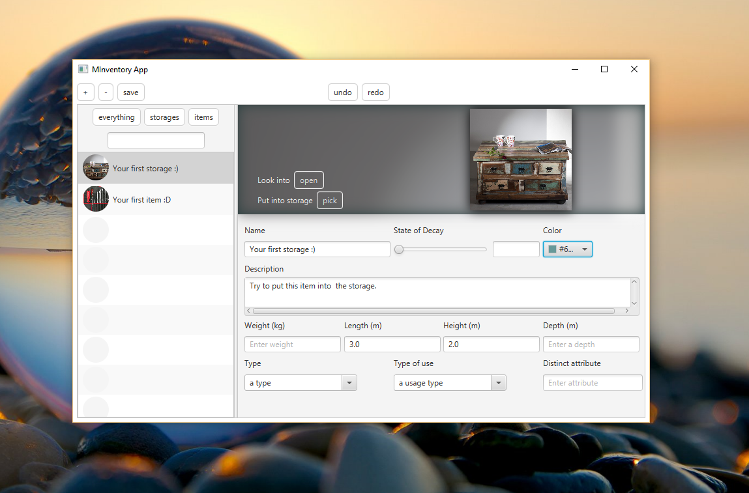
Layout

Slide 3
Features
Search Filter
Drag n Drop images
Add remove Undo redo
Files saved in user home
Put item/storage into storage
Delayed undo redo behaviour
Resizable Images

Slide 4
Fazit
Lukas Willin - https://github.com/LukasWilllinFHNW/MInventory
Viel gelernt durch
Abschauen, Diskutieren, Research

